Slide 1
Nutritional Disorders Vitamins and Minerals ((Vitamins B complex
Dr. Zainab A. Al-Mayyahi
Department of Medicine
College of Medicine
University of Basrah

Slide 2
Objectives
By the end of this lecture you should be able to
Define Vitamins
Classify vitamins
Identify causes of vitamins deficiencies
Describe the clinical features of vitamins deficiency and excess
Treat vitamins related nutritional disorders

Slide 3
Thiamine (Vitamin B₁)
Thiamine pyrophosphate plays an important role in energy (ATP) generation.
Functions of B1:
Decarboxylation of ketoacids (pyruvic acid, lactic acid).
A coenzyme for a transketolase reaction (pentose and hexose metabolism).
Plays a role in peripheral nerve conduction.

Slide 4
Sources and daily requirements
Daily requirement: 2 mg/d.
Food sources: yeast, meat, legumes, whole grains, and nuts. Milled rice or grains contain little thiamine.
Tea and coffee contain thiaminases, which can destroy the vitamin.
The body have limited stores of B1 so deficiency occur after one month of B1 free diet.

Slide 5
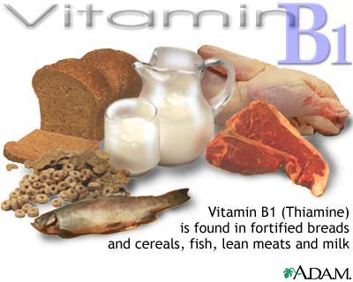

Slide 6
Thiamine deficiency
Causes :
Alcoholism.
Poor dietary intake(rice based diet).
Long-term parenteral nutrition.
Chronic illnesses.
Pregnancy.
Chronic diuretics therapy.
Heavy coffee and tea consumption.

Slide 7
Clinical features of thiamine deficiency
In early stage anorexia, irritability and decrease in short-term memory.
Prolonged thiamine deficiency causes “beriberi”, tow types of beriberi:
Wet beriberi.
Dry beriberi.

Slide 8
Clinical features of thiamine deficiency
Wet beriberi : presents primarily with cardiovascular symptoms, due to impaired myocardial energy metabolism and dysautonomia, and can occur after 3 months of a thiamine-deficient diet.
Patients present with an enlarged heart, tachycardia, high-output CHF and peripheral edema.

Slide 9
Clinical features of thiamine deficiency
Dry beriberi : present with a symmetric peripheral neuropathy of the motor and sensory systems with diminished reflexes. The neuropathy affects the legs more than the arms.

Slide 10
Clinical features of thiamine deficiency
Wernicke's encephalopathy: is a CNS syndrome caused by thiamine deficiency in alcoholics; nystagmus, ophthalmoplegia, ataxia, and mental impairment, it can be precipitated by large CHO dose without B1.
Wernicke-Korsakoff syndrome : occurs when there is an additional loss of memory and a confabulatory psychosis.

Slide 11
Diagnosis of thiamin deficiency
Assay of transketolase activity measured before and after the addition of thiamine pyrophosphate.
Thiamine in serum or blood can also be measured by HPLC.
Urinary thiamine excretion.

Slide 12
Treatment of thiamine deficiency
Acute thiamine deficiency is an emergency whether cardiovascular or neurological.
Treatment is 100 mg/d of thiamine parenterally for 7 days, followed by 10 mg/d orally until there is complete recovery.
Improvement occurs within 24 hours. But Wernicke-Korsakoff psychosis may be permanent.

Slide 13
Riboflavin (Vitamin B₂)
Functions of riboflavin :
Coenzyme in metabolism of fat , carbohydrate, and protein.
Plays a role in drugs and steroid metabolism, including detoxification reactions.

Slide 14
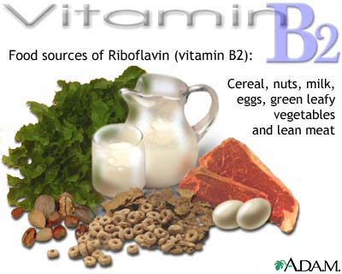

Slide 15
Vitamin B2 deficiency
Causes : rare in developed countries, mainly caused by under-nutrition and alcoholism, occurs together with other vitamins deficiencies.
Clinical features : glossitis, angular stomatitis, cheilosis, skin lesions, corneal vascularization, anemia, and personality changes.

Slide 16
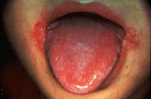
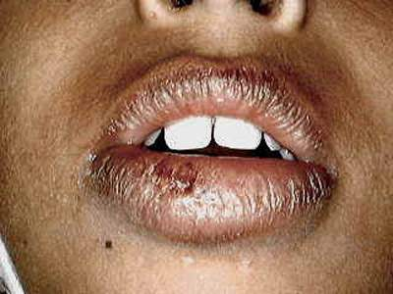
Vitamin B2 deficiency

Slide 17
Diagnosis and treatment
Diagnosis : measurement of red blood cell or urinary riboflavin concentrations.
Treatment : B2 replacement usually together with other vitamin B complex

Slide 18
Niacin (Vitamin B₃)
Niacin refers to nicotinic acid and nicotinamide and their metabolites.
It is a precursor of NAD and NADP which are important in :
Numerous oxidation- reduction reactions and in DNA repair.
High doses of nicotinic acid (2 g/d) are used for the treatment of hyperlipidemia.

Slide 19
Sources and daily requirement
Sources : milk, meat, fish, poultry, nuts and eggs.
Niacin can be synthesized from tryptophan from vegetables sources but this reaction requires B6 and B2
Daily requirement : 15 -20 mg /day.
Requirement increase in pregnancy and lactation.

Slide 21
Niacin deficiency (Pellagra)
Causes of niacin deficiency:
Dietary deficiency ( corn based diet).
Alcoholism.
Hartnup disease ( defect in tryptophan absorption)
Carcinoid syndrome( increase consumption of tryptophan).
B6 and B2 deficiency.

Slide 22
Clinical features of Pellagra
Loss of appetite, generalized weakness and irritability, abdominal pain, and vomiting.
Bright red glossitis.
Dermatitis
Diarrhea (in part due to proctitis and in part due to malabsorption).
depression, seizures, and dementia.

Slide 23
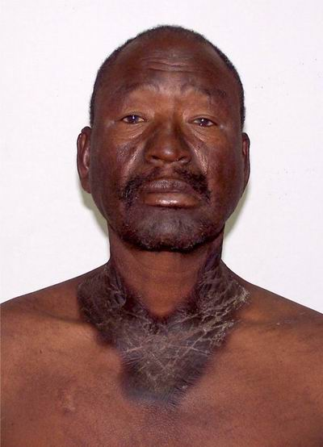
Clinical features of Pellagra
A characteristic rash, pigmented, scaling, in sun exposed skin known as “Casal's necklace” because it forms a ring around the neck.
Pellagra = 4Ds dermatitis, diarrhea, dementia and death.

Slide 24
Diagnosis and treatment
Diagnosis:
Clinical features.
Niacin metabolites assay in urine.
Treatment :
100–200 mg of niacin three times daily for 5 days.

Slide 25
Niacin toxicity
Doses > 50 mg may cause flushing, skin dryness, itching, parasthesia, headache, nausea, vomiting, and abdominal pain.
Hepatic toxicity is the most serious toxic reaction due to niacin and may present as jaundice with elevated AST and ALT levels.

Slide 26
Pyridoxine (Vitamin B₆)
Function of B6:
It is a cofactor for more than 100 enzymes involved in amino acid metabolism.
Involved in heme and neurotransmitters synthesis.
Involved in the metabolism of several vitamins like niacin.

Slide 27
Sources and daily requirements
Sources : rich sources are legumes, nuts, wheat bran, and meat, although it is present in all food groups.
B₆ from plants is less bioavailable than that from animal tissues.
Daily requirements: 2 mg /d.

Slide 28
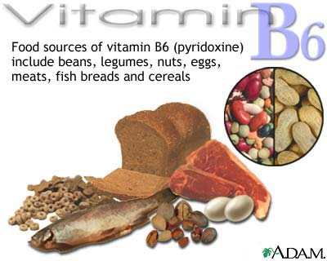
daily requirement 2mg/d

Slide 29
Pyridoxine deficiency
B6 will affect the epithelial tissues, bone marrow and the nervous system.
Causes of B6 deficiency include:
Nutritional insufficiency.
Drugs like isoniazid (INH).

Slide 30
Clinical features of B6 deficiency
Glossitis, angular stomatitis, dermatitis.
Microcytic, hypochromic anemia.
Peripheral neuropathy, personality changes, depression, confusion and seizures especially in infants.

Slide 31
Diagnosis and treatment
Diagnosis:
low plasma level of pyridoxine.
Treatment : B6 orally 50 mg/d.

Slide 32
Pyridoxine toxicity
Chronic use of high doses of B6 > 100 mg /day can cause severe sensory neuropathy.
Photosensitivity and dermatitis have also been reported.

Slide 33
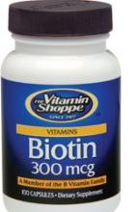
Biotin (vitamin B7)
Functions : plays a role in gene expression, gluconeogenesis, fatty acid and amino acid synthesis.

Slide 34
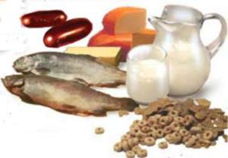
Sources of B7
Sources of vitamin B7 include fish, meat, soy, beans, yeast, cheese and milk.

Slide 35
Biotin deficiency
Clinical features : Biotin deficiency is rare, may presents with mental changes (depression, hallucinations), paresthesia, anorexia, nausea and a scaling, seborrheic, skin rash.
Treatment : vitamin B7 replacement.

Slide 36
Folate (vitamin B9)
The active form of folate and folic acid is tetrahydrofolate (THF) which is important in the synthesis of amino acids and nucleic acids. (DNA replication).

Slide 37
Sources and daily requirements
Sources: green vegetables, yeast, liver, meat, citrus fruits, shellfish and whole grains.
Daily requirements : 100 μg /day.
Body stores is 10 mg which is adequate for few months only.

Slide 38
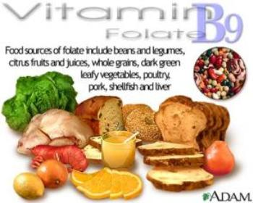

Slide 39
Metabolism of folate
Folic acid
DHF
DHF reductase
THF
DNA synthesis
B12
Methyl THF

Slide 40
Folate deficiency
Folate deficiency will lead to impaired DNA synthesis and this especially affects rapidly dividing cells in the bone marrow leading to a (megalobastic bone marrow).

Slide 41
Causes of folate deficiency
Malnutrition.
Malabsorption ( e.g. coeliac disease).
Pregnancy ( increased requirements).
Chronic hemolytic anemias ( thalassemia, sickle cell anemia ).
Dugs: antiepileptics, trimethoprim, methotrexate.

Slide 42
Clinical features of folate deficiency
The main clinical features is megaloblastic anemia.
Hemolytic jaundice
Glossitis, angular stomatitis and cheilosis.
Bruising due to thrombocytopenia.
low leukocyte count predispose to infections.

Slide 43
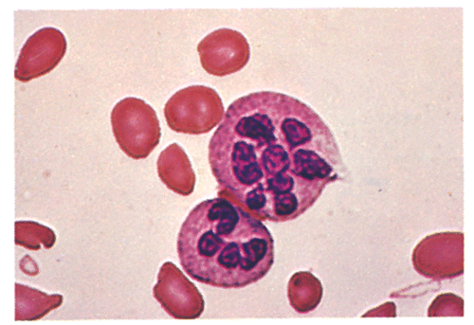
Diagnosis of folate deficiency
Clinical features.
Serum folate.
Red cell folate.
Blood indices and blood film morphology.

Slide 44
Treatment of folate deficiency
Treatment of the underlying cause.
Oral folic acid 5–15 mg daily for 4 months.
Prophylactic Folic Acid for:
Pregnant and lactating women.
Chronic hemolytic anemias.

Slide 45
Cobalamin (vitamin B₁₂)
Functions :
A coenzyme in folate metabolism.
Important for DNA synthesis.
Important for myelin integrity in the nervous system.

Slide 46
Sources and daily requirements
Sources : food of animal origin, meat, fish, and dairy products.
Daily requirements : 1-5 μg /day.
Body stores is 3-5 mg which is adequate for 2-3 years.

Slide 47
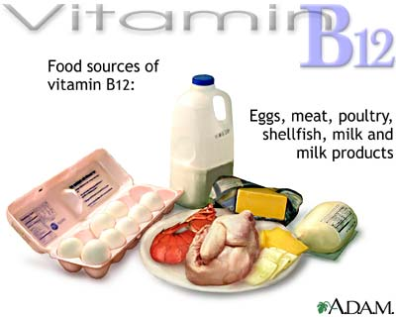

Slide 48
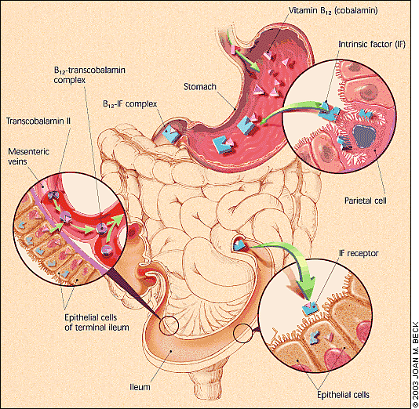
Absorption and metabolism
Absorption of vitamin B12 (cobalamin)

Slide 49
Cobalamin deficiency
Cobalamin deficiency will lead to:
Megaloblastic changes in the bone marrow.
Neurological changes due to defect in myelin synthesis.

Slide 50
Causes of Cobalamin deficiency
Vegetarians ( vegans).
Intrinsic factor deficiency ( gastroectomy, gastric atrophy, pernicious anemia).
Diseases of the terminal ilium (Crohn’s).
Increased consumption of B12 in the gut (bacterial overgrowth, fish tape worm disease).
Congenital defects in transcobalamin.

Slide 51
Clinical features of B12 deficiency
Megaloblastic anemia, glossitis, angular stomatitis and cheilosis similar to folate deficiency.
Neurological features include:
Bilateral peripheral neuropathy : paresthesia, muscle weakness, or difficulty in walking.
Degeneration (demyelination) of the spinal cord (subacute combined degeneration of the cord).
Optic atrophy, ataxia, dementia, psychosis.

Slide 52
Diagnosis of B12 deficiency
Clinical features.
Serum cobalamin measured by ELISA.
Blood indices and film morphology.
Tests for cobalamin absorption (Schilling’s test).

Slide 53
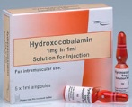
Treatment of B12 deficiency
Treatment of the underlying cause.
Six 1000 μg IM injections of hydroxocobalamin given at 3- to 7-day intervals is enough to replenish stores.
For maintenance therapy, 1000 μg hydroxocobalamin IM once every 3 months.

